Slide 1
Operating systems: Windows and it’s Variants

Slide 2
Operating System
Responsible for the management and coordination of activities and the sharing of the resources of a computer
Acts as a host for computing applications run on the machine.
Determines which applications should run in what order and how much time should be allowed for each application before giving another application a turn

Slide 3
Kernal
Is the central component of most computer operating systems.
It is a bridge between applications and the actual data processing done at the hardware level.
Responsibilities include managing the system's resources (the communication between hardware and software components).

Slide 4
Functions of OS
It handles input and output process
It sends messages to each application or interactive user about the status of operation and any errors
It can off load the management of what are called batch jobs so that the initiating application is freed from this work (i.e. print spool)
It can manage how to divide the program (in parallel processing)

Slide 5
Windows and It’s Variants
Microsoft Windows is a family of operating systems. We look at the history of Microsoft's Windows operating systems (Windows OS) from 1985 to present day
Windows dominates the personal computer world, running, by some estimates, more than 90 percent of all personal computers – the remainder running Linux and Mac operating systems.
Microsoft also offers operating systems for servers and mobile devices.

Slide 6


Slide 7
MS-DOS - Microsoft Disk Operating System (1981)
Originally developed by Microsoft for IBM,
MS-DOS was the standard operating system for IBM-compatible personal computers.
The initial versions of DOS were very simple and resembled another operating system called CP/M.
Subsequent versions have become increasingly sophisticated as they incorporated features of minicomputer operating systems.

Slide 8
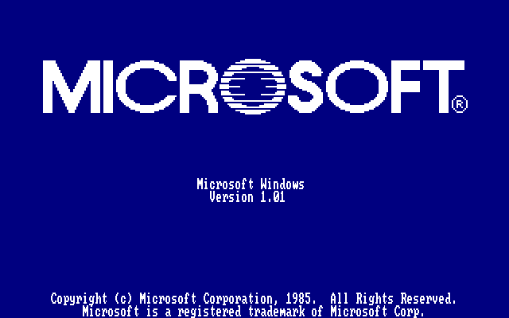

Slide 9
Windows 1.0 – 2.0 (1985-1992)
Introduced in 1985,
Microsoft Windows 1.0 was named due to the computing boxes, or "windows" that represented a fundamental aspect of the operating system.
Instead of typing MS-DOS commands, windows 1.0 allowed users to point and click to access the windows.
In 1987 Microsoft released Windows 2.0, which was designed for the Intel 286 processor. This version added desktop icons, keyboard shortcuts and improved graphics support.

Slide 10
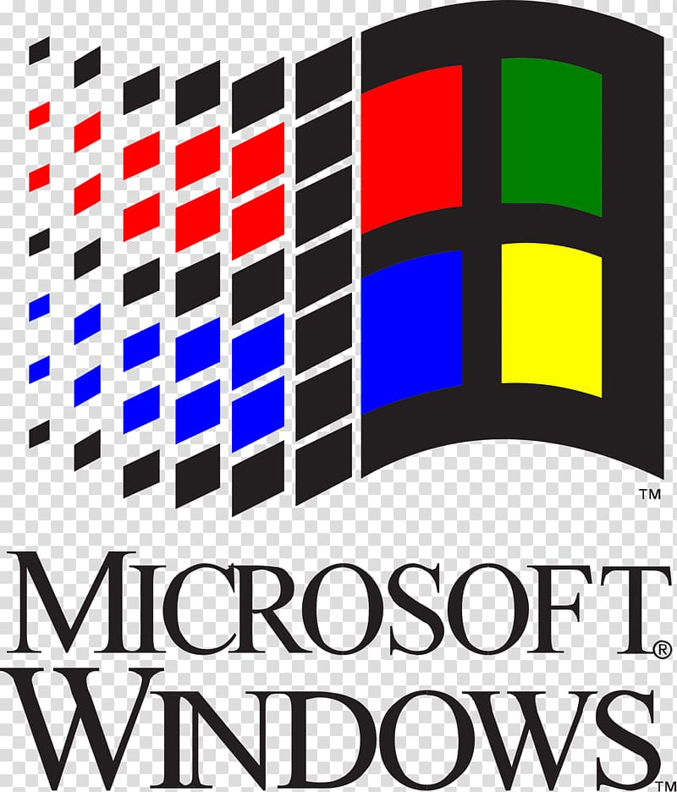

Slide 11
Windows 3.0 – 3.1 (1990–1994)
Windows 3.0 was released in May, 1990 offering better icons, performance and advanced graphics with 16 colors designed for Intel 386 processors.
This version is the first release that provides the standard "look and feel" of Microsoft Windows for many years to come.
Windows 3.0 included Program Manager, File Manager and Print Manager and games (Hearts, Minesweeper and Solitaire).
Microsoft released Windows 3.1 in 1992.

Slide 12
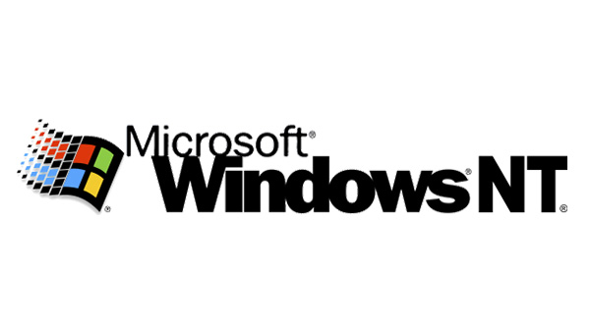

Slide 13
Windows NT 31. - 4.0 (1993-1996)
A version of the Windows operating system. Windows NT (New Technology) is a 32-bit operating system that supports preemptive multitasking.
There are actually two versions of Windows NT:
  Windows NT Server, designed to act as a server in networks, and
  Windows NT Workstation for stand-alone or client workstations.

Slide 14
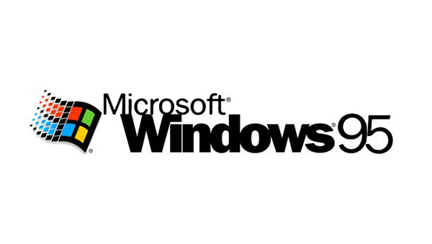

Slide 15
Windows 95 (August 1995)
It was released in 1995 and was a major upgrade to the Windows operating system.
This OS was a significant advancement over Windows 3.1.
It supports 32-bit applications, which means that applications written specifically for this operating system should run much faster.
It removed many of the old DOS limitations, such as 640K of main memory and 8-character filenames.
Other important features in this operating system are the ability to automatically detect and configure installed hardware (plug and play).

Slide 16
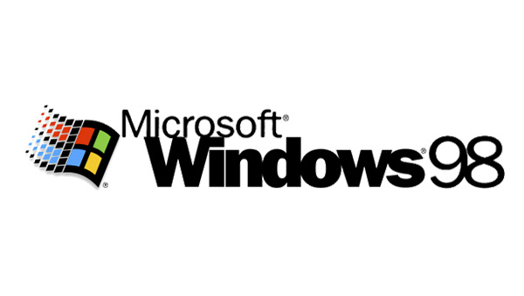

Slide 17
Windows 98 (June 1998)
It offers support for a number of new technologies, including FAT32, AGP, MMX, USB, DVD, and ACPI.
Its most visible feature, though, is the Active Desktop, which integrates the Web browser (Internet Explorer) with the operating system.
From the user's point of view, there is no difference between accessing a document residing locally on the user's hard disk or on a Web server halfway around the world.

Slide 18
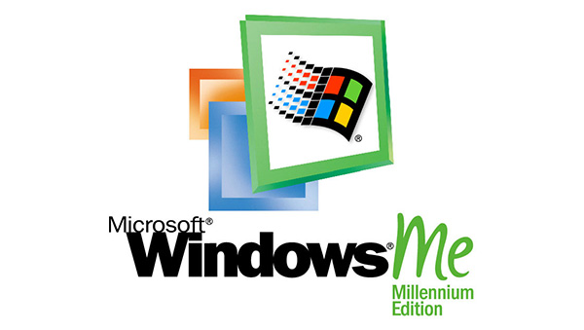

Slide 19
Windows ME - Millennium Edition (September 2000)
The Windows Millennium Edition, called "Windows Me" was an update to the Windows 98 core and included some features of the Windows 2000 operating system.
This version also removed the "boot in DOS" option.

Slide 20
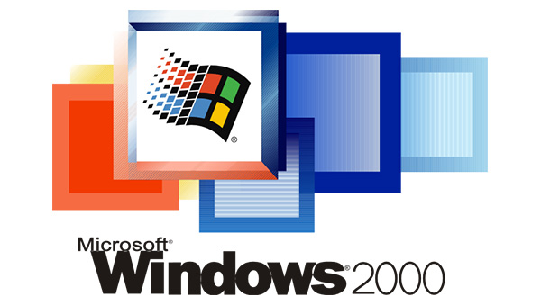

Slide 21
Windows 2000 (February 2000)
Often abbreviated as "W2K," Windows 2000
It is an operating system to run software applications, connect to Internet and intranet sites, and access files, printers, and network resources.
Microsoft released four versions of Windows 2000:
  Professional (for business desktop and laptop systems),
  Server (both a Web server and an office server),
  Advanced Server (for line-of-business applications) and
  Datacenter Server (for high-traffic computer networks).

Slide 22
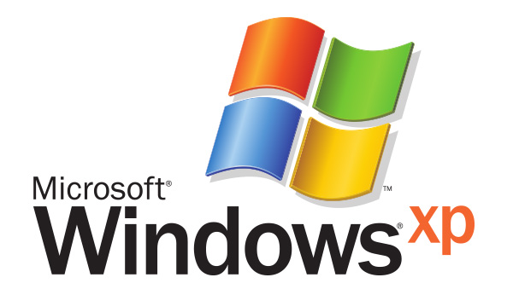

Slide 23
Windows XP (October 2001)
Along with a redesigned look and feel to the user interface, the new operating system is built on the Windows 2000 kernel,
Giving the user a more stable and reliable environment than previous versions of Windows.
Windows XP comes in two versions,
  Home and
  Professional.
Microsoft focused on mobility, including plug and play features for connecting to wireless networks.
The operating system also utilizes the 802.11x wireless security standard.
Windows XP is one of Microsoft's best-selling products.

Slide 24
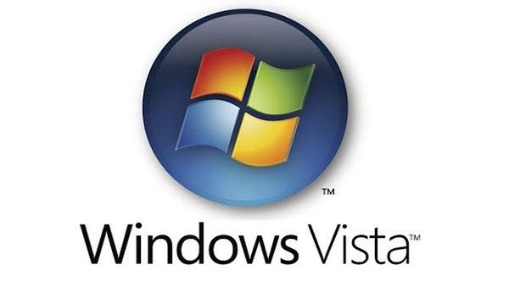

Slide 25
Windows Vista (November 2006)
Windows Vista offered an advancement in reliability, security, ease of deployment, performance and manageability over Windows XP.
New in this version was capabilities to detect hardware problems before they occur, security features to protect against the latest generation of threats, faster start-up time and low power consumption of the new sleep state.
In many cases, Windows Vista is noticeably more responsive than Windows XP on identical hardware.
Windows Vista simplifies and centralizes desktop configuration management, reducing the cost of keeping systems updated.

Slide 26
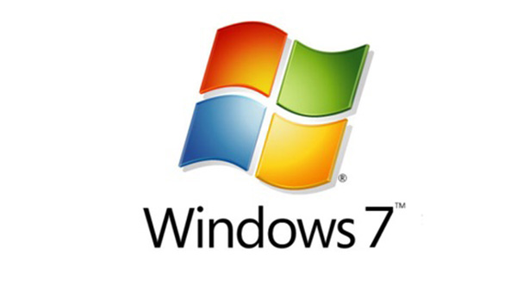

Slide 27
Windows 7 (October, 2009)
Windows 7 was released as the successor to Windows Vista (which itself had followed Windows XP).
Windows 7 was released in conjunction with Windows Server 2008 R2, Windows 7's server counterpart.
Enhancements and new features in Windows 7 include multi-touch support, Internet Explorer 8, improved performance and start-up time, Aero Snap, Aero Shake, support for virtual hard disks, a new and improved Windows Media Center, and improved security.

Slide 28
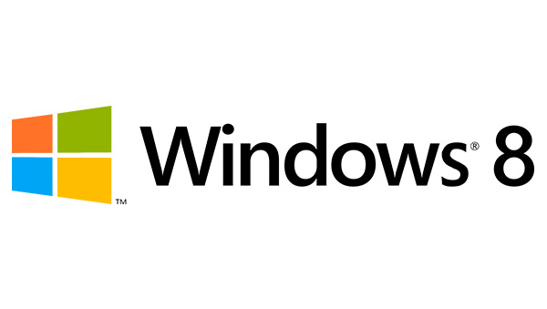

Slide 29
Windows 8 (August, 2012)
Windows 8 was a completely redesigned operating system with touch screen use in mind as well as near-instant-on capabilities that enable a Windows 8 PC to load and start up in a matter of seconds rather than in minutes.
Windows 8 replaced the more traditional Microsoft Windows OS look and feel with a new "Metro" design system interface that first debuted in the Windows Phone 7 mobile operating system.
The Metro user interface primarily consists of a "Start screen" made up of "Live Tiles," which are links to applications and features that are dynamic and update in real time.
Windows 8 supports both x86 PCs and ARM processors.

Slide 30
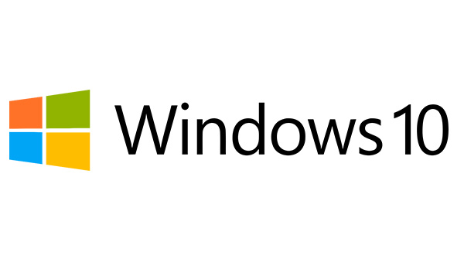

Slide 31
Windows 10 (July 2015)
Windows 10 is Microsoft's Windows successor to Windows 8.
Microsoft claims Windows 10 features fast start up and resume, built-in security and the return of the Start Menu in an expanded form.
This version of Windows will also feature Microsoft Edge, Microsoft's new browser.
Any qualified device (such as tablets, PCs, smartphones and Xbox consoles) can upgrade to Windows 10, including those with pirated copies of Windows.

Slide 32
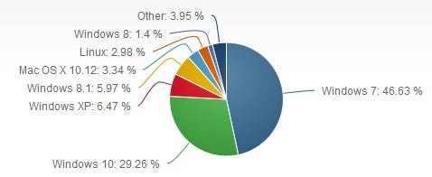
Market Share Statistics for Internet Technologies
The following image indicates the total market share of all desktop operating systems (November, 2017)

